Slide 1


Slide 2


Project Title
Second Year Project Synopsis
Submitted by
ROLL | NAME
2301010188 | Shikhar Bajpai
2301010162 | Priyanshu Tomar
2301010161 | Kumud Rathi
2301010153 | Ram Ratan Sah
Industry Mentor: Ms Mansi Parihar
Faculty Mentor: Mr Amit
Notes:
New Courses replaced with New Programmes

Slide 3

Project Overview
The Virtual Coding Interview Platform is designed to improve the remote hiring process by providing an integrated solution for video interviews, real-time coding assessments, and automated feedback. The platform enables recruiters to schedule, conduct, and evaluate interviews seamlessly, ensuring a smooth, secure, and efficient experience for both recruiters and candidates. With its user-friendly interface and end-to-end encryption, this platform aims to simplify the hiring process, saving time and resources while providing accurate evaluations.
Notes:
New Courses replaced with New Programmes

Slide 4
About the Problem
Problem
Need of Solution
Existing Solution
Fragmented Systems– Multiple tools for video interview, coding assessment and scheduling cause inefficiencies
Communication Delays- Lack of real-time updates leads to miscommunications and delays.
Inflexible Platforms- Existing solution don’t support various interviews (coding based)
Unified Platform- A single solution that integrates video, coding assessments, Scheduling , feedbacks and screen sharing.
Secure & Scalable- High level security measures including anti cheating mechanisms
Disjointed Tools- Platforms like Google Meet or Zoom are often used separately for video interviews with no integrated coding environment.
Limited Security – There platforms don’t offer the ability to customize interview formats or secure the environments to prevent cheating
Notes:
New Courses replaced with New Programmes

Slide 5
Problem Statement
Problem Definition- Current recruitment tools (e.g., Google Meet, Zoom) are not integrated with coding assessments, scheduling, and feedback, leading to inefficiencies. These platforms allow candidates to cheat by accessing external resources during interviews or coding assessments.
Why is it Important?
Ensuring a secure and seamless recruitment process is critical for hiring the right candidates and maintaining fair competition. Cheating undermines the assessment's integrity and leads to poor hiring decisions.
Expected Impact of Solving This Problem
Streamlined Process: An integrated platform would provide a unified solution, making interviews and assessments more efficient and secure.
Reduced Cheating: Implementing anti-cheating mechanisms would ensure fair assessments, leading to more reliable hiring decisions.
Improved Candidate Experience: A smooth, secure process enhances the experience for both recruiters and candidates, making the hiring process more transparent and professional.
Notes:
New Courses replaced with New Programmes

Slide 6
Objectives
Develop an integrated virtual interview platform that enhances the recruitment process through secure, real-time video interviews, coding assessments with an integrated compiler, and seamless feedback.
Specific Objectives
Build a unified platform that combines video interviews, coding assessments, scheduling, and an integrated compiler.
Ensure high-level security features, including anti-cheating mechanisms and data encryption, to protect the integrity of the process.
Provide a flexible, scalable platform that can adapt to different interview types and organizational needs.
Notes:
New Courses replaced with New Programmes

Slide 7
Methodology, Tools, and Techniques
Approach taken to solve the problem
Requirement Analysis: Identify gaps in existing platforms like Zoom and Google Meet.
System Design: Develop a scalable and modular architecture.
Feature Implementation:
Real-time video interviews
Integrated collaborative code editor.
Tools, Software, and Techniques Used
Frontend: We used React.js combined with Next.js for server-side rendering and routing.
Authentication: Managed using Clerk, which allows for secure and fast login/signup functionality.
Video Calling: Powered by Stream Video React SDK, which allows for real-time video communication.
Code Editor: Implemented using the Monaco Editor, which is the same editor behind Visual Studio Code.
Backend: We use Convex as our database solution, providing real-time synchronization and serverless architecture. Convex simplifies data handling, ensuring smooth operation across sessions. Data such as user accounts, meeting information, and real-time updates are stored and retrieved from Convex. Logic and data flow are handled directly through Next.js API routes, integrating seamlessly with Convex.
Notes:
New Courses replaced with New Programmes

Slide 8
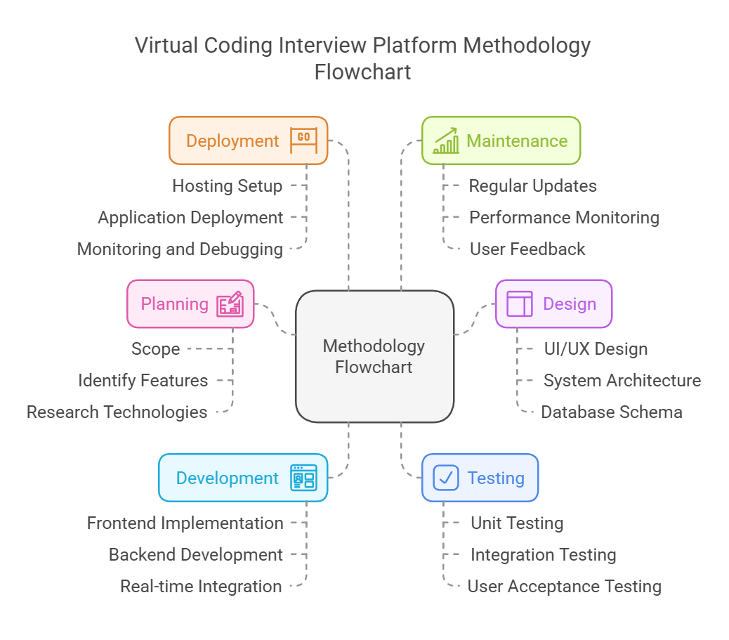
Methodology Flowchart
Notes:
New Courses replaced with New Programmes

Slide 9
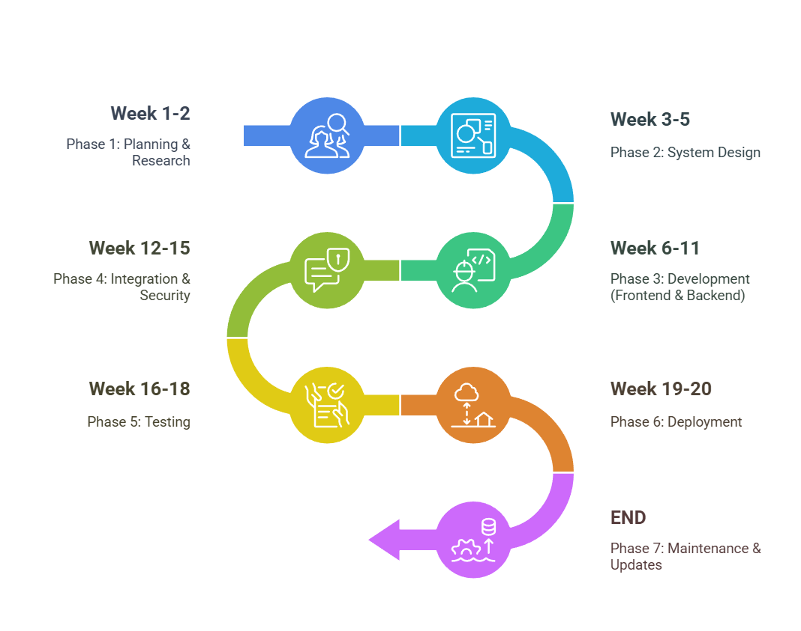
Project Timeline
Notes:
New Courses replaced with New Programmes

Slide 10
Expected Results & Impact
Expected Results
Real-time, low-latency video communication between users.
Secure and seamless login/signup experience using Clerk.
Instant collaborative code editing with live updates via Monaco Editor.
Consistent and reliable backend operations using Convex for real-time data synchronization.
Smooth user interface and fast page loads with React.js and Next.js integration.
Impact
Enables remote teams, students, and developers to collaborate more efficiently.
Provides an all-in-one platform combining video calling and coding, improving workflow.
Enhances productivity by offering real-time communication and collaboration tools.
Supports scalable, secure, and user-friendly virtual workspaces for education, hackathons, and corporate use.
Sets a benchmark for building future real-time collaborative applications with minimal technical overhead.
Notes:
New Courses replaced with New Programmes

Slide 11
References
[1] Google Scholar, "Platforms for remote interviews: Issues and remedies," accessed at: https://scholar.google.com.
[2] R. Patel and K. Sharma, "The significance of real-time communication in online interviews," Journal of Online Education, vol. 18, no. 4, pp. 112-118, 2023.
[3] L. Zhang and J. Lee, "Employing WebRTC for efficient video interviewing," International Journal of Software Engineering, vol. 27, no. 2, pp. 80-88, 2022.
[4] AWS, "Solutions based on cloud technology for video conferencing applications," Amazon Web Services, accessed at: https://aws.amazon.com.
[5] JDoodle, "Execution of code in real time for digital interviews," accessed at: https://www.jdoodle.com/.
[6] Replit, "Platforms for collaborative coding in prompt assessments," accessed at: https://replit.com.
Notes:
New Courses replaced with New Programmes

Slide 12
THANK YOU

